Slide 1
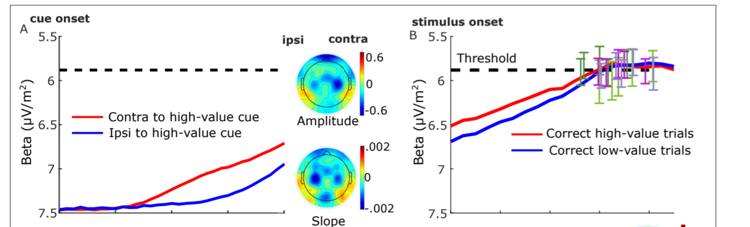
MB update 29/July/2024
Update MB baseline (f-domain)
Update Triger delay 60-70ms
Update spec analysis for FDI vs BCP
SL- just before stimuli (-188)
RL-just before resp. (-188 before end)

Slide 2
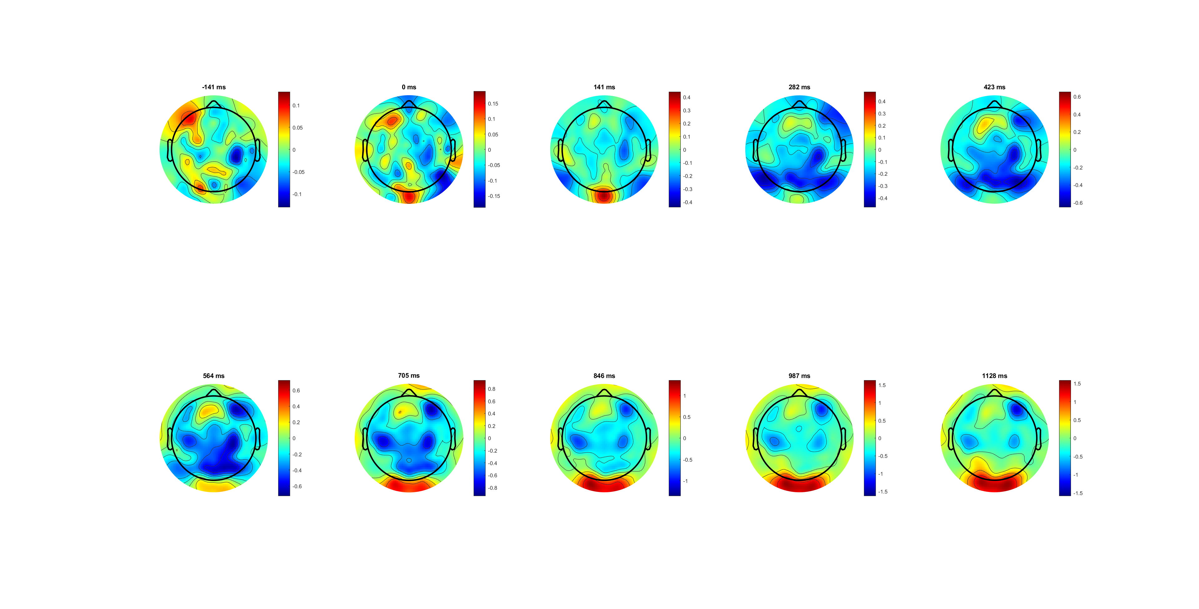
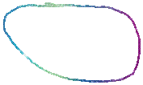
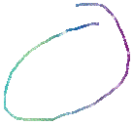
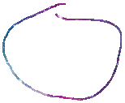
Left only Correct (dymic limit)

Slide 3
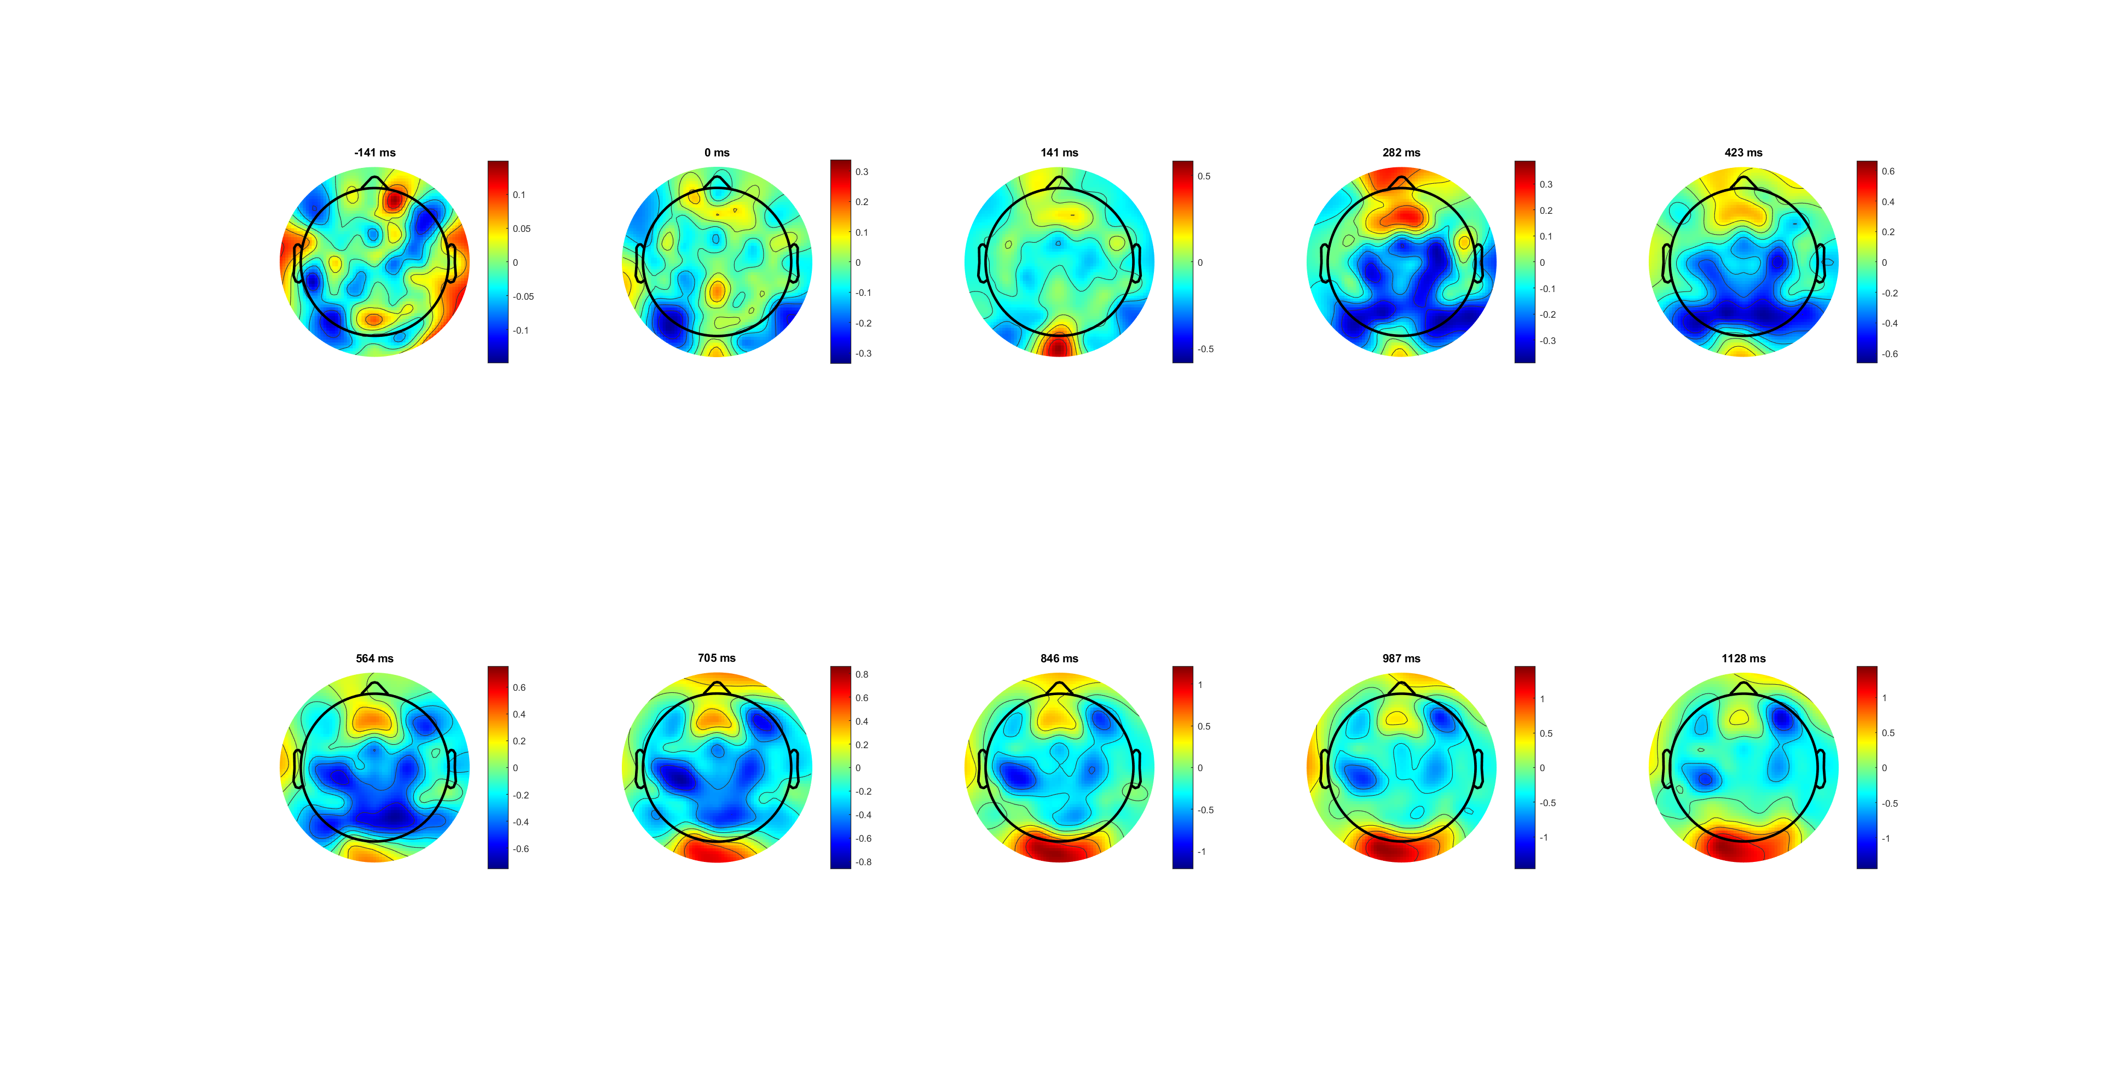
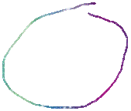
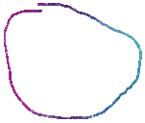
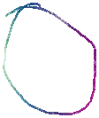
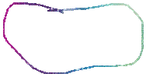
Right only correct

Slide 4
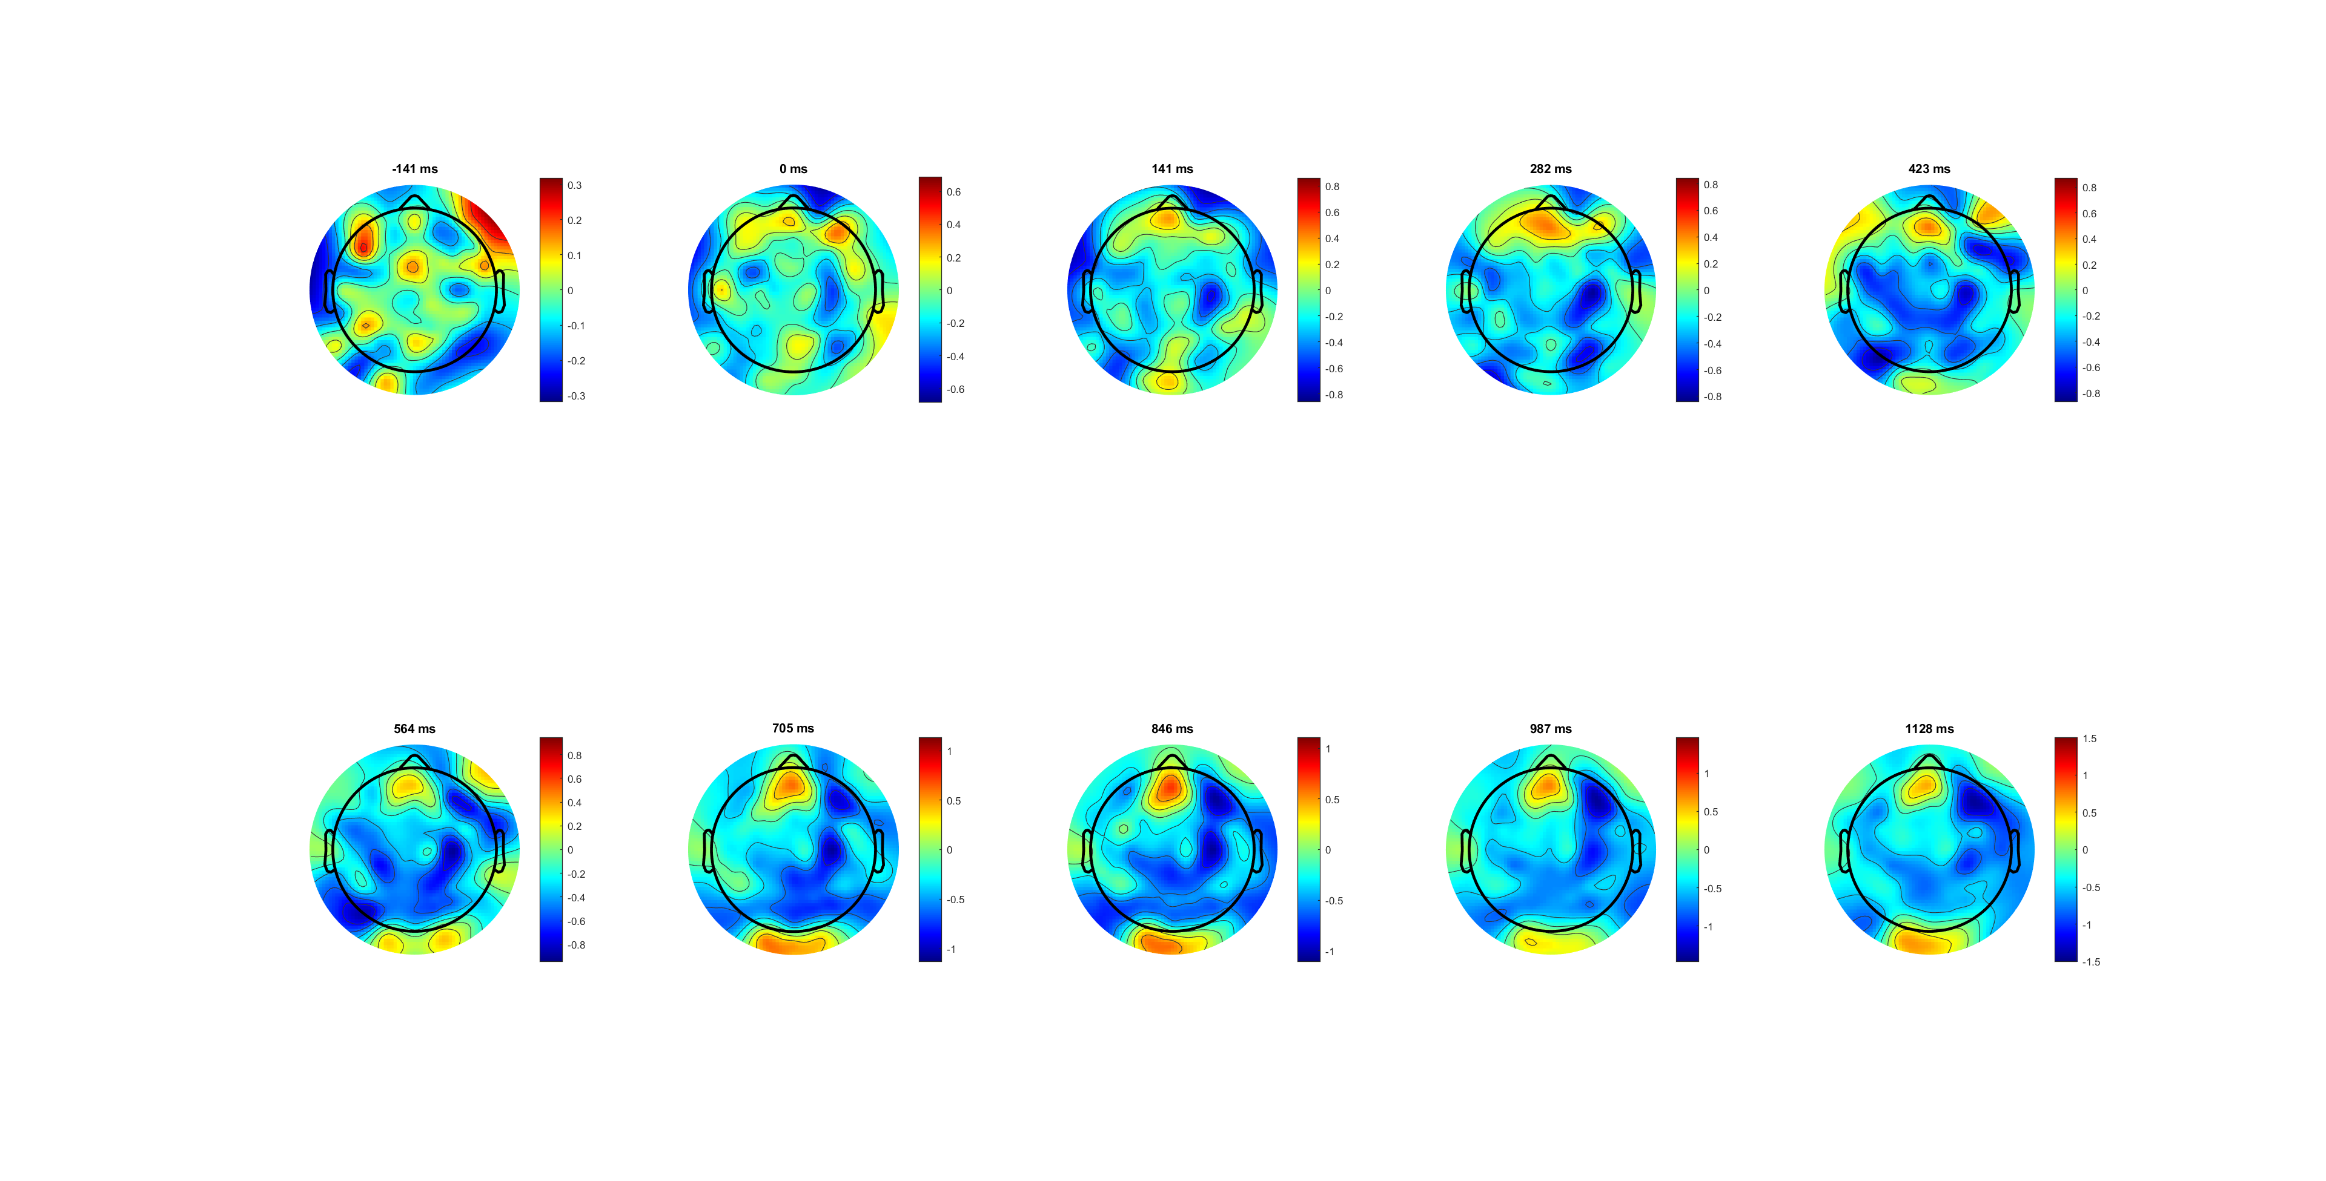
Left only wrong

Slide 5
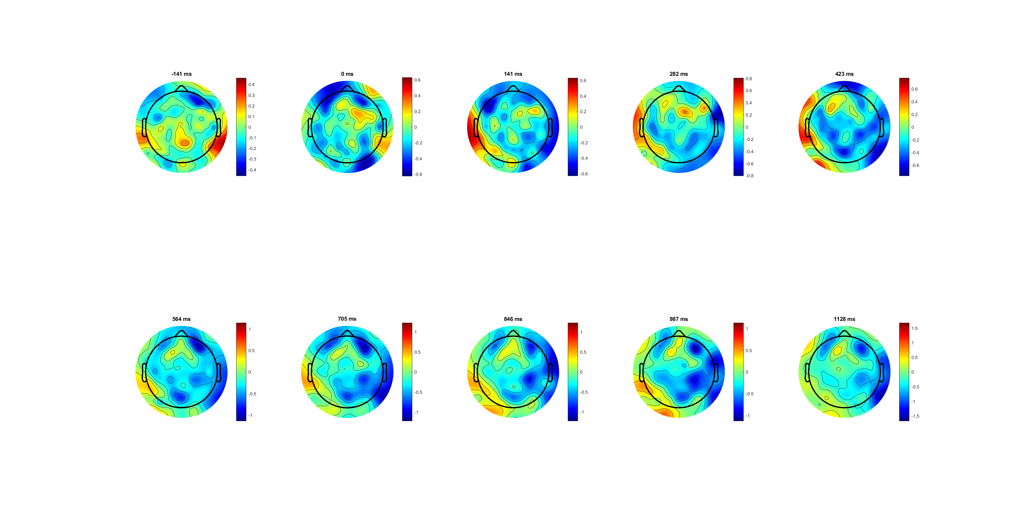
Right only wrong

Slide 6
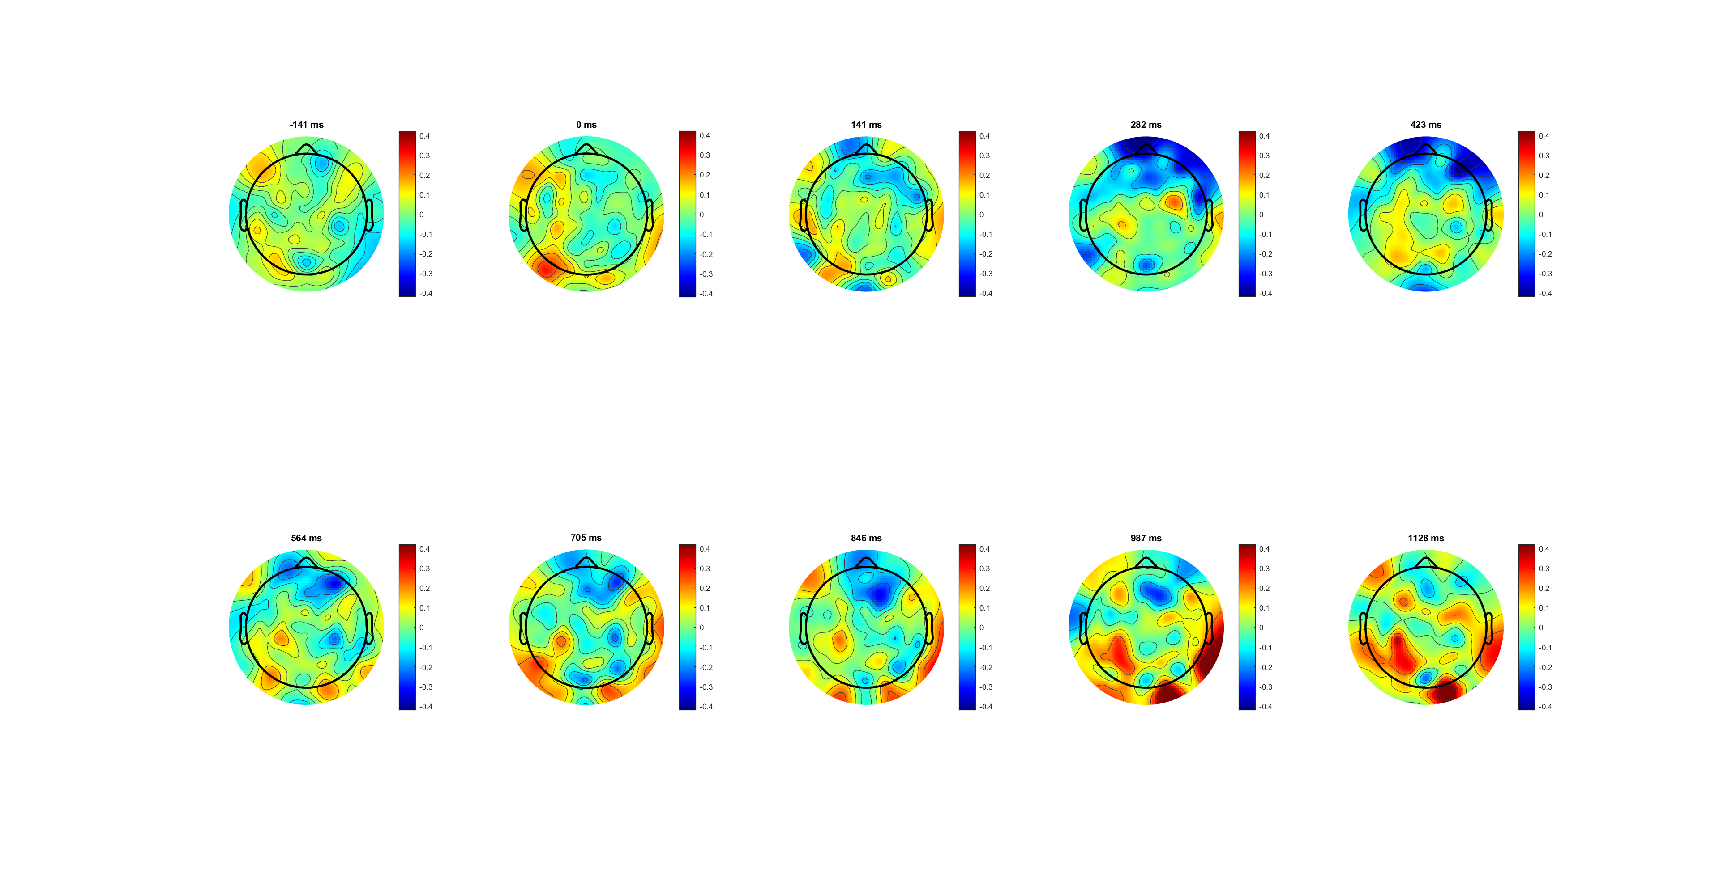
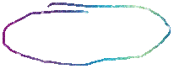
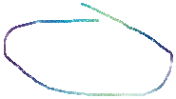
Correct lateralisation (L-R) 0.4limit
amplitude is lower contralateral to the button that was pressed

Slide 7
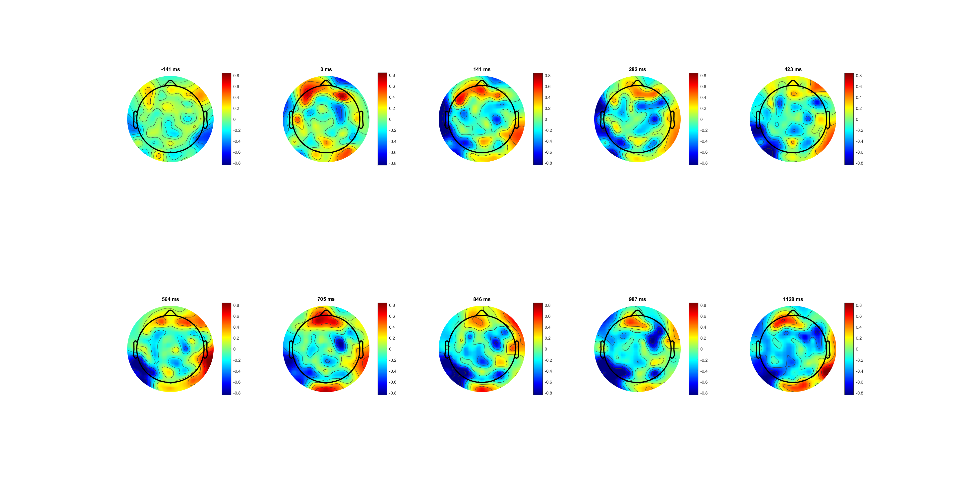
Wrong lateralisation (L-R) 0.8lim

Slide 8
Add average baseline?

Slide 9
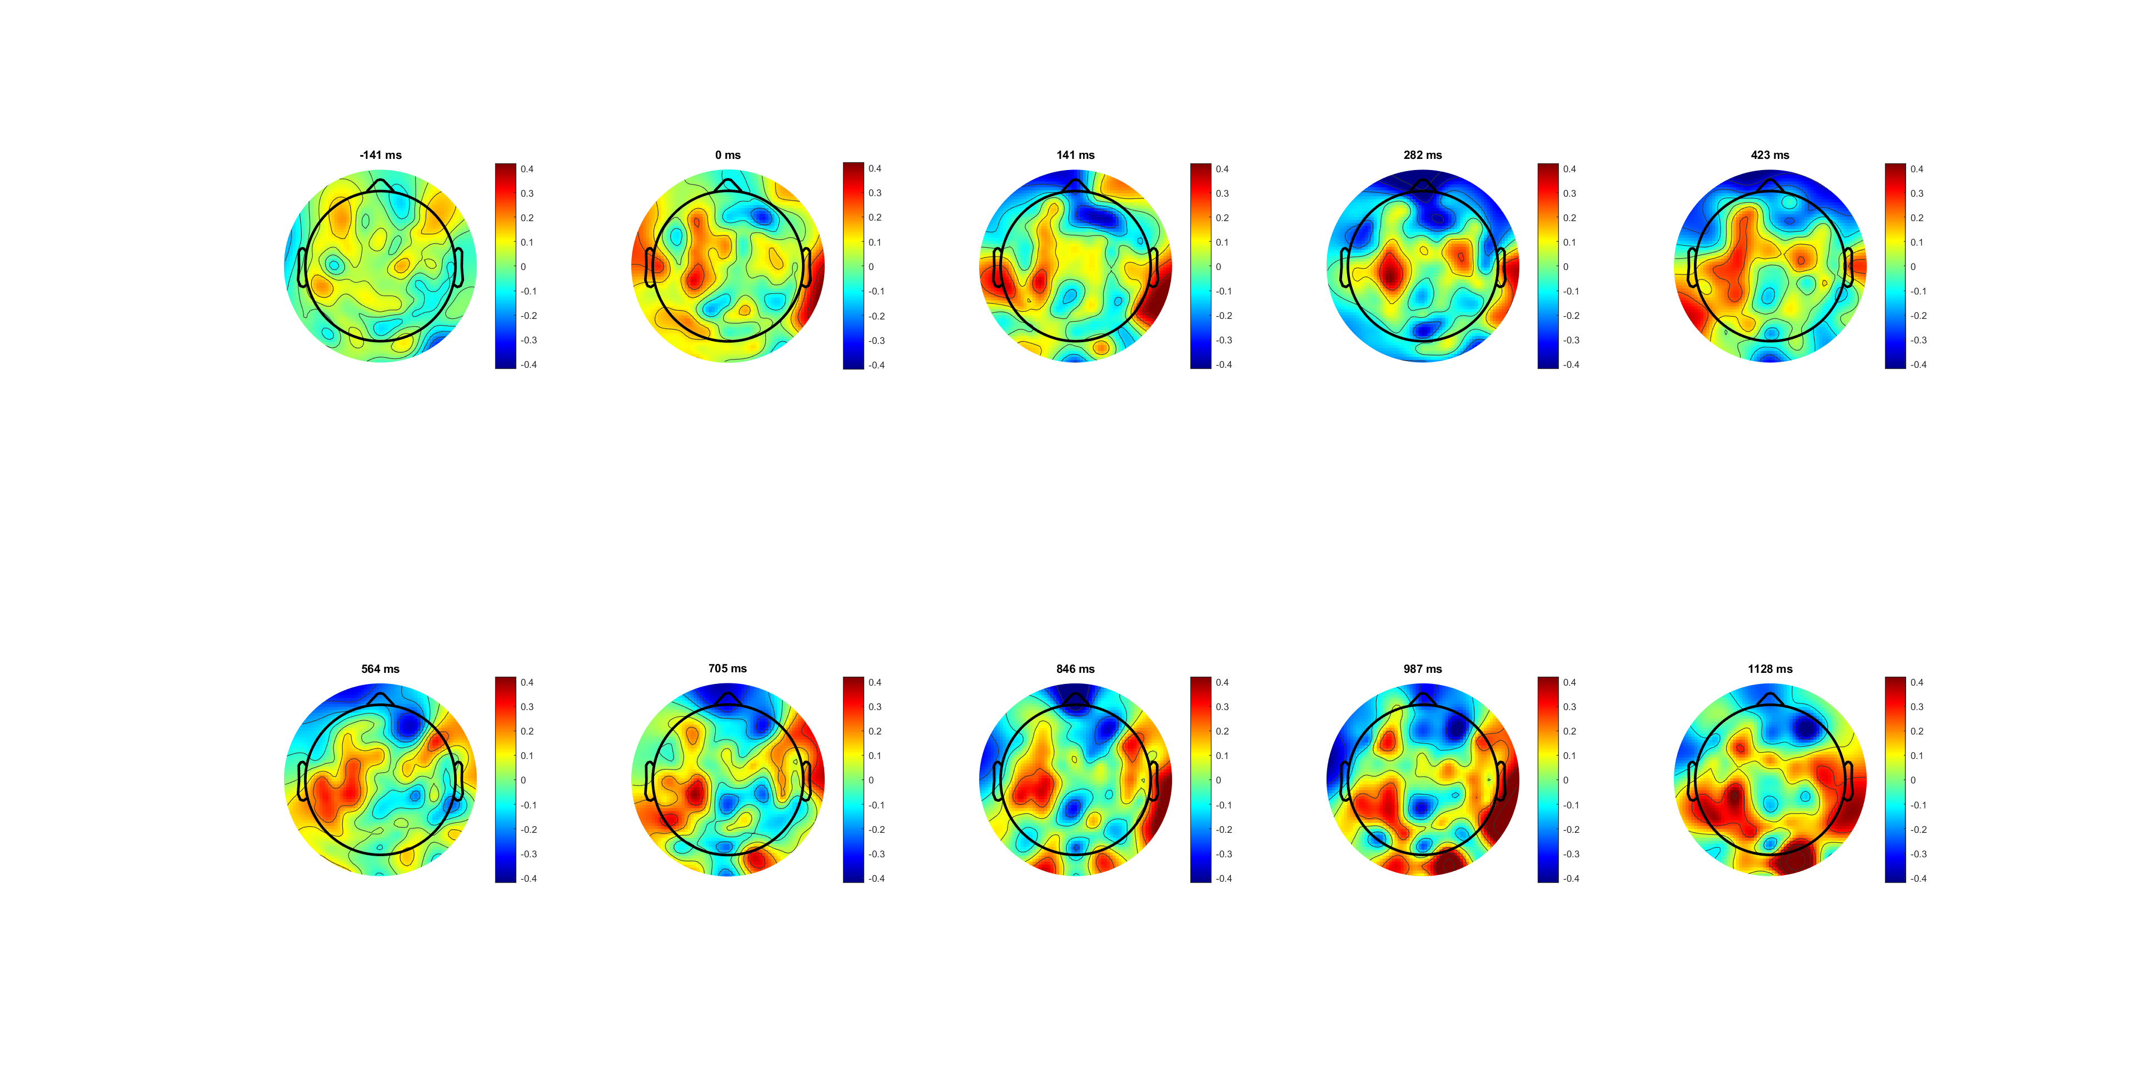

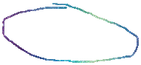
High 0.14 correct lateralisation (L-R) 0.4lim

Slide 10
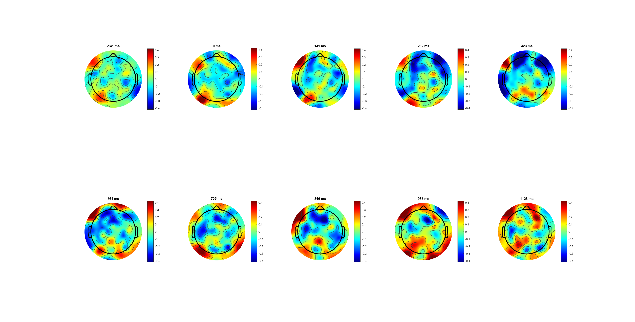


Low 0.07 correct lateralisation (L-R) 0.8lim

Slide 12
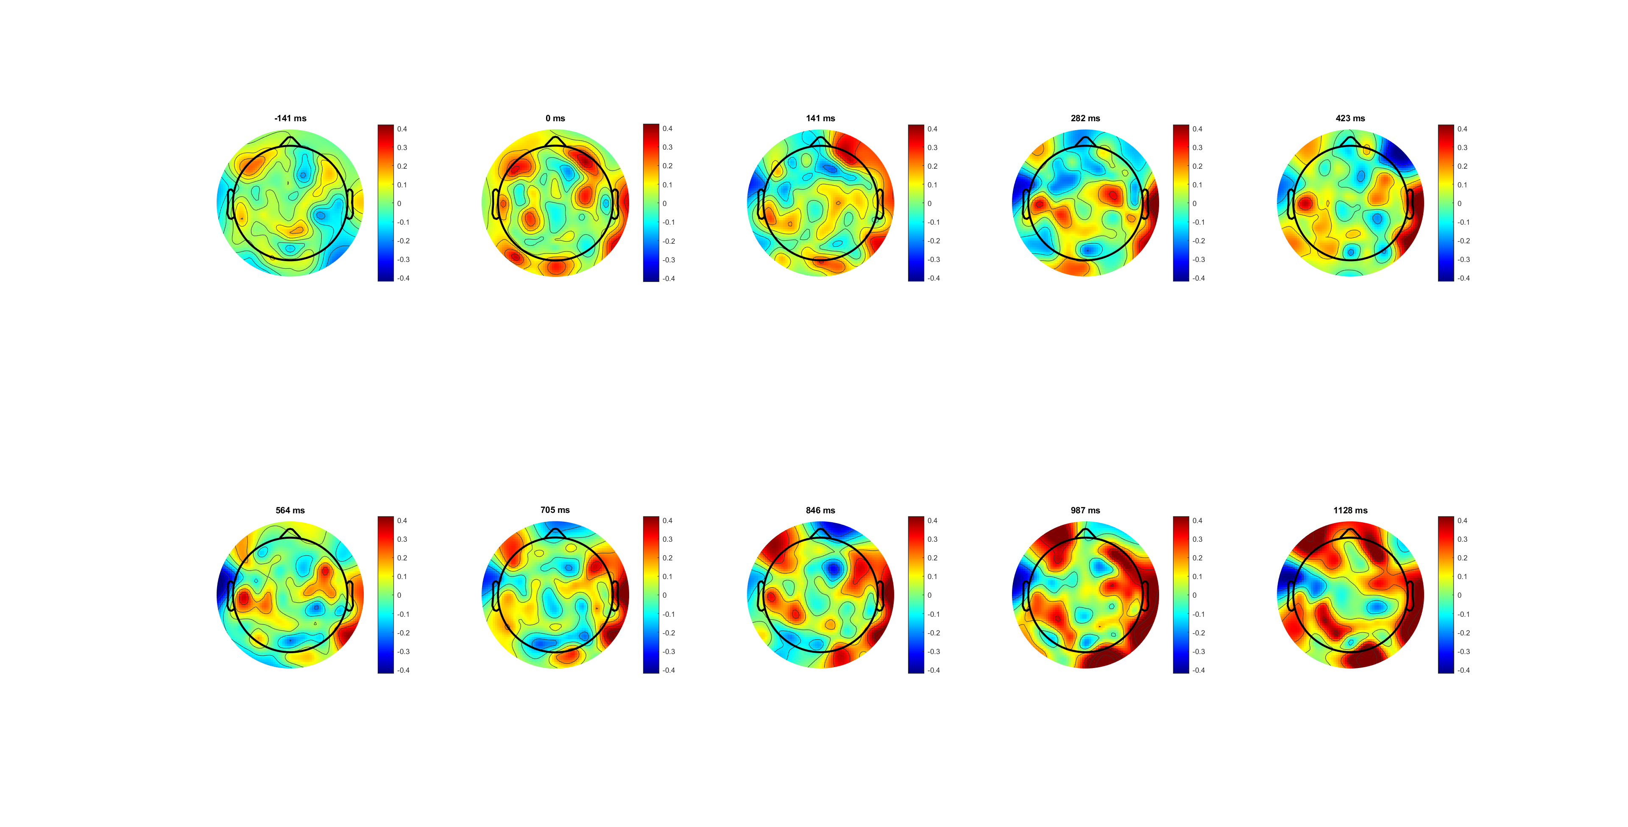
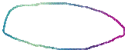
FDI

Slide 13
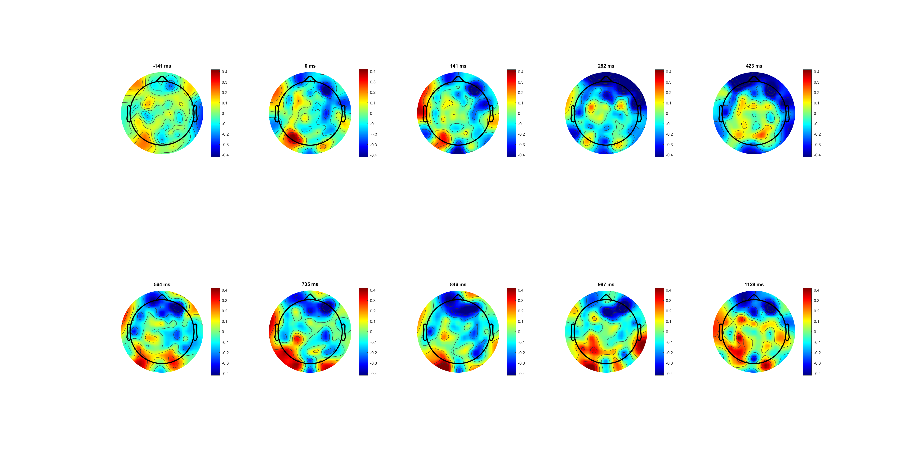

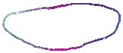
BCP

Slide 14
Different channels for FDI BCP?

Slide 15
find electrodes of interest； look at how the different frequency bands evolve over time for bicep and finger.

Slide 16
FDI (C3/4+) BCP (C3/4+)
The lateralization (left- right) of BCP is more obvious than that of FDI
*muscle amount diff/ control diff

Slide 17
116 55
BCP is in mu /low beta band is higher, and FDI is higher in high beta band
FDI reactivated due to CoMs

Slide 18
FDI (C3/4) BCP (C3/4)
C3/4 has less diff between left and right
The lateralization (left- right) of BCP is more obvious than that of FDI
*muscle amount diff/ control diff

Slide 19
115 54
BCP is in mu /low beta band is higher, and FDI is higher in high beta band
FDI reactivated due to CoMs

Slide 20
RL
RL-just before resp. (-188 before end)

Slide 21
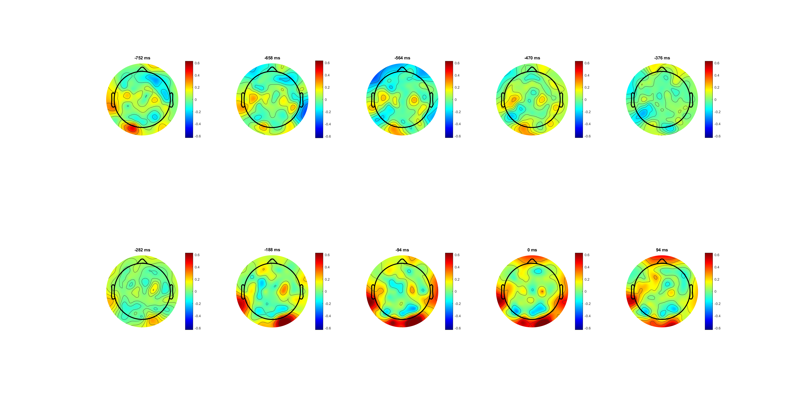
Correct lateralisation (L-R)

Slide 22
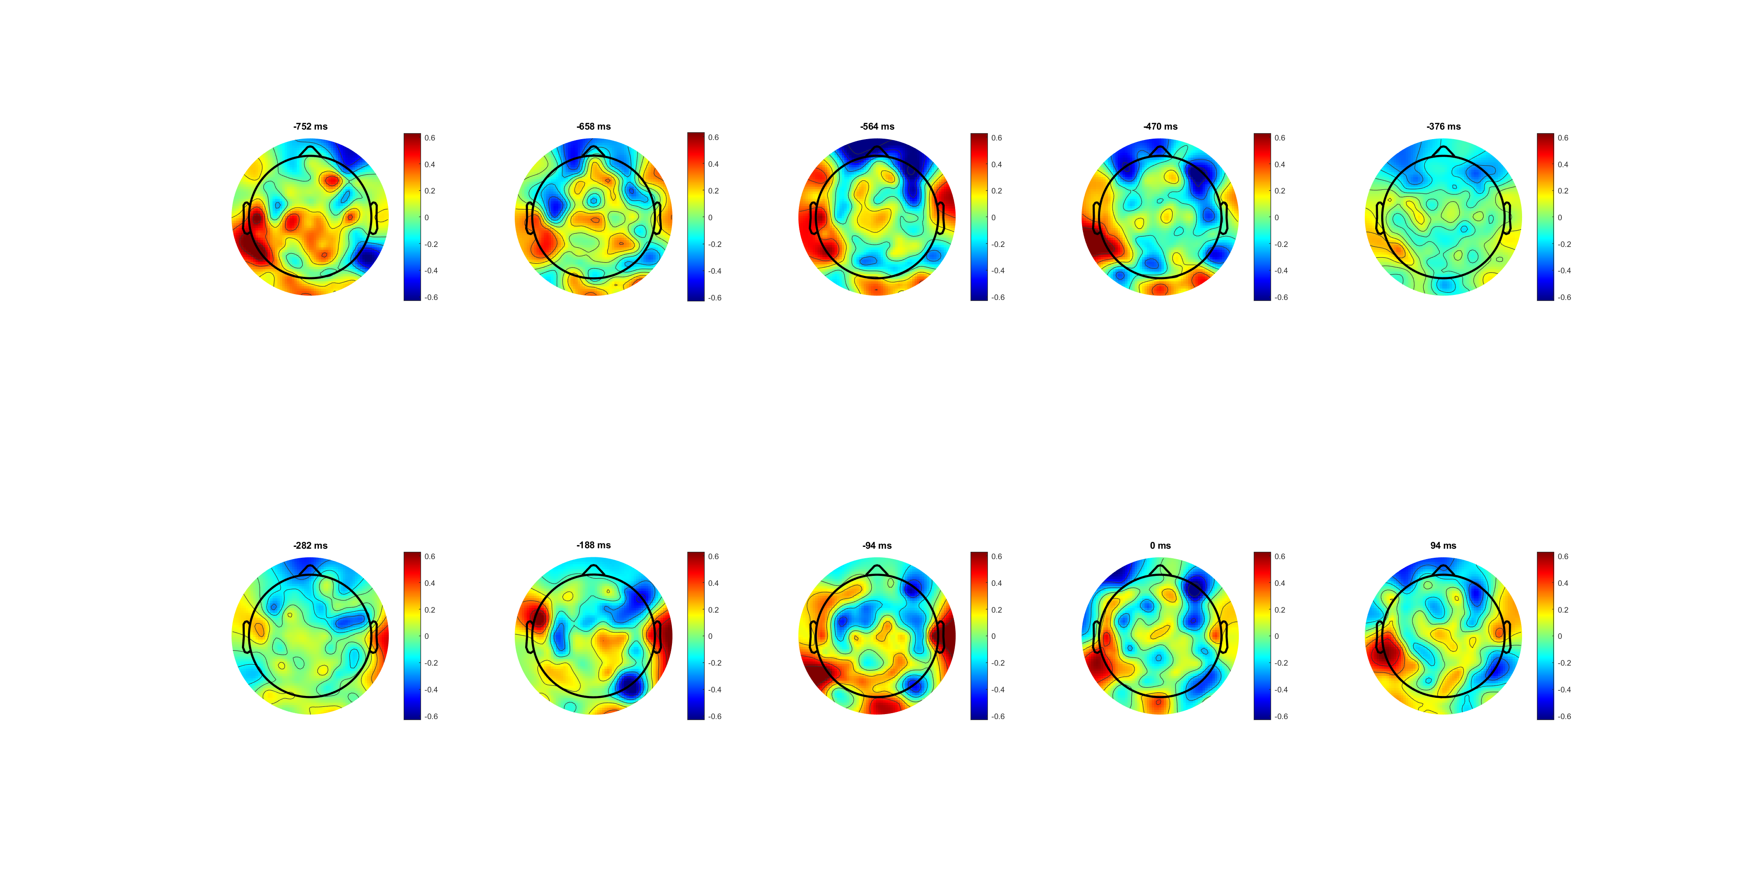
Wrong lateralisation (L-R)

Slide 24
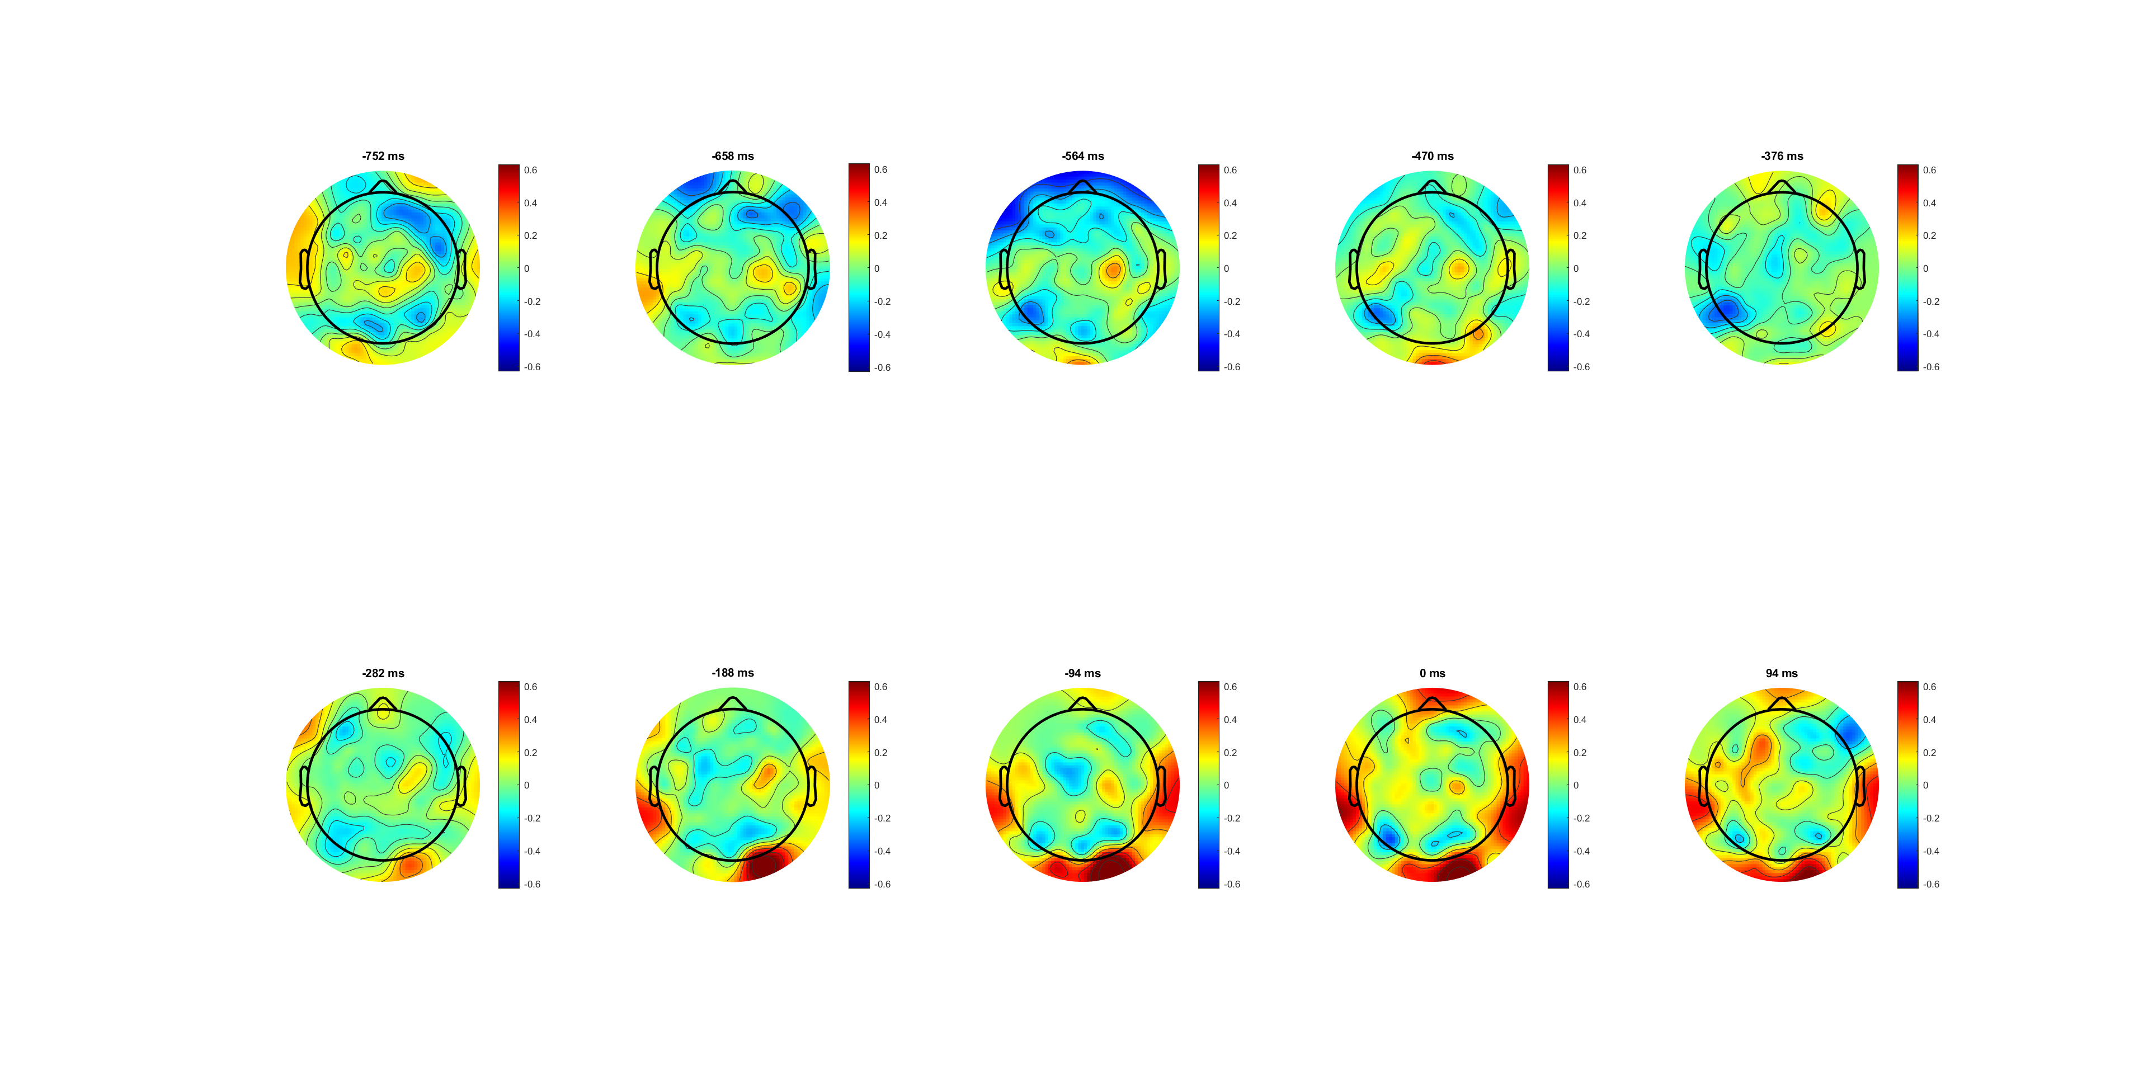
High 0.14 correct lateralisation (L-R)

Slide 25
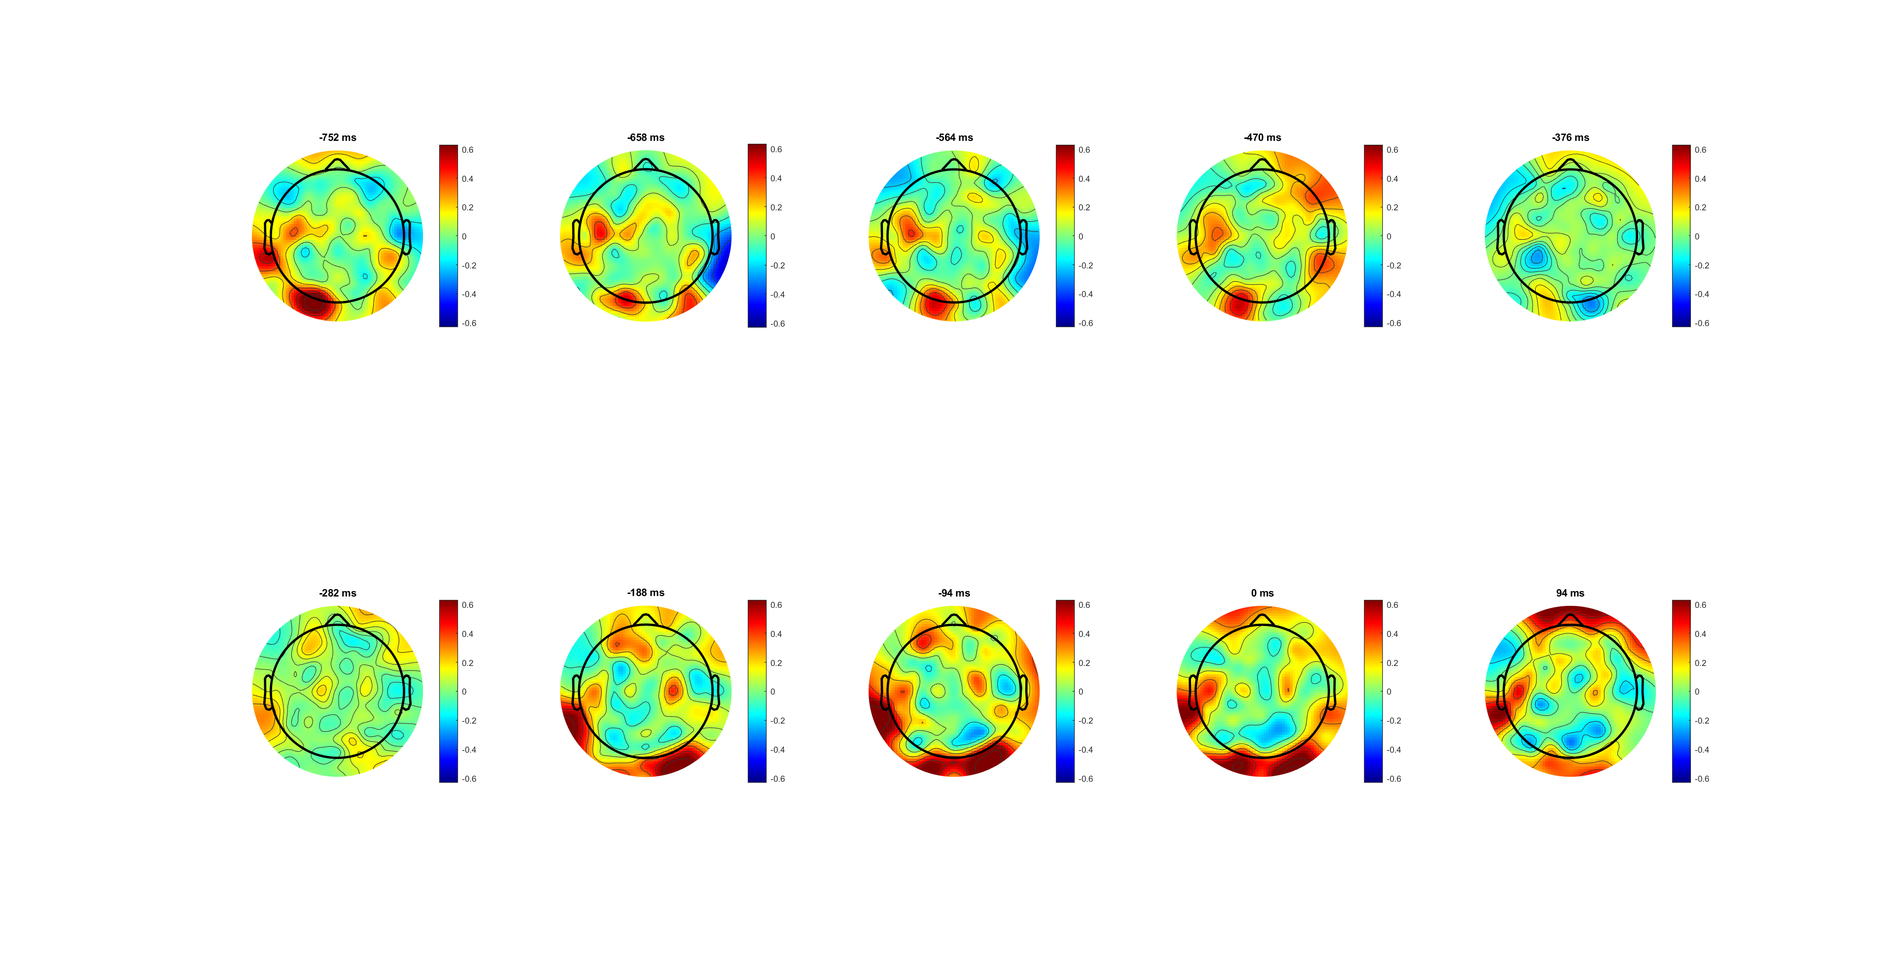
Low 0.07 correct lateralisation (L-R)

Slide 27
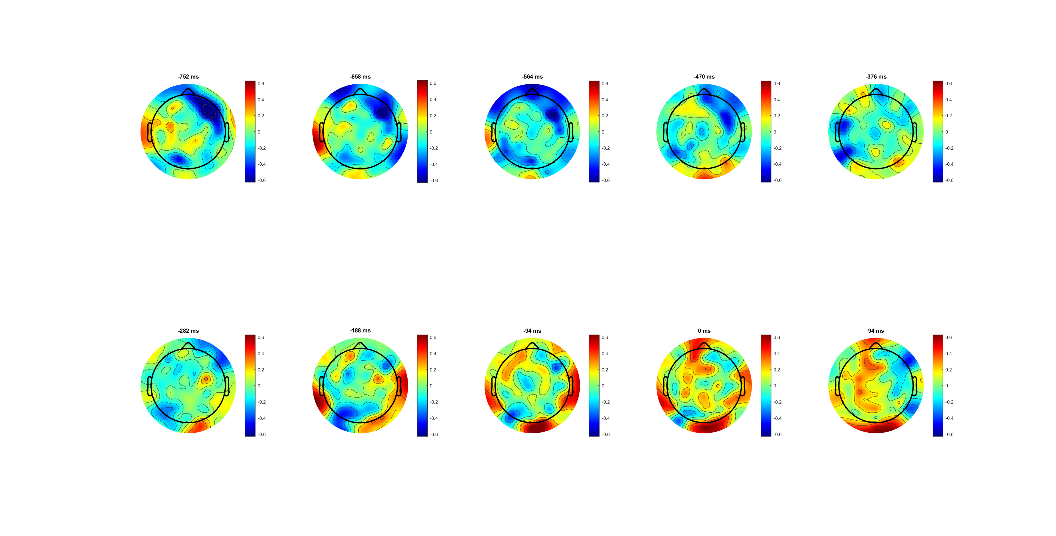

Slide 28
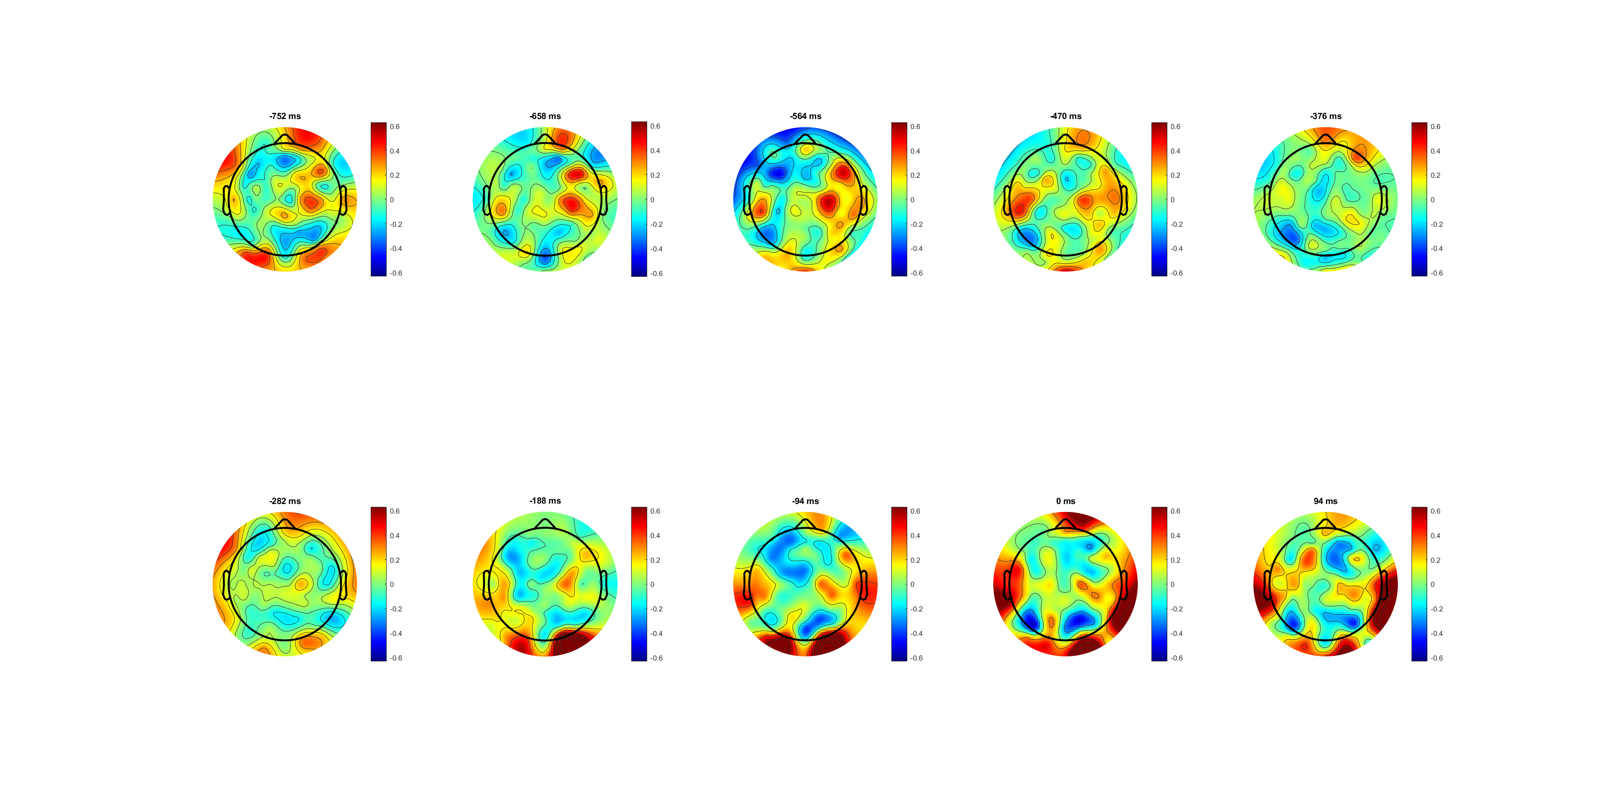

Slide 30
FDI (C3/4) BCP (C3/4)
The lateralization (left- right) of BCP is more obvious than that of FDI
*muscle amount diff/ control diff

Slide 31
115 54
BCP is in mu /low beta band is higher, and FDI is higher in high beta band

Slide 32
FDI (C3/4+) BCP (C3/4+)

Slide 33
116 55

